Slide 1
EDUC2323 Computer Programming as a Tool for Learning
Guess the Number

Slide 2
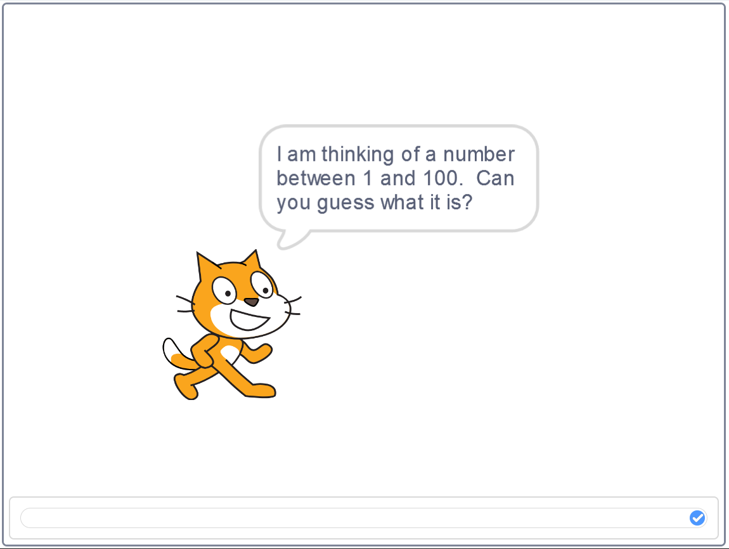
Guess the Number
https://scratch.mit.edu/projects/246726979/

Slide 3
Programming and learning concepts for today…
Debugging
Defining variables, and storing and reading values in them
Capturing user input from the keyboard
Comparing numbers
Some more complex examples of conditional statements

Slide 4
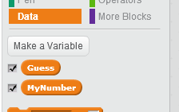
Variables
A variable is a memory cell that can remember a value. A value can be stored in a variable, which remembers the value until it is changed by a later store. The current value within a variable can be read.
(Armoni & Ben-Ari, 2013: 86)

Slide 5
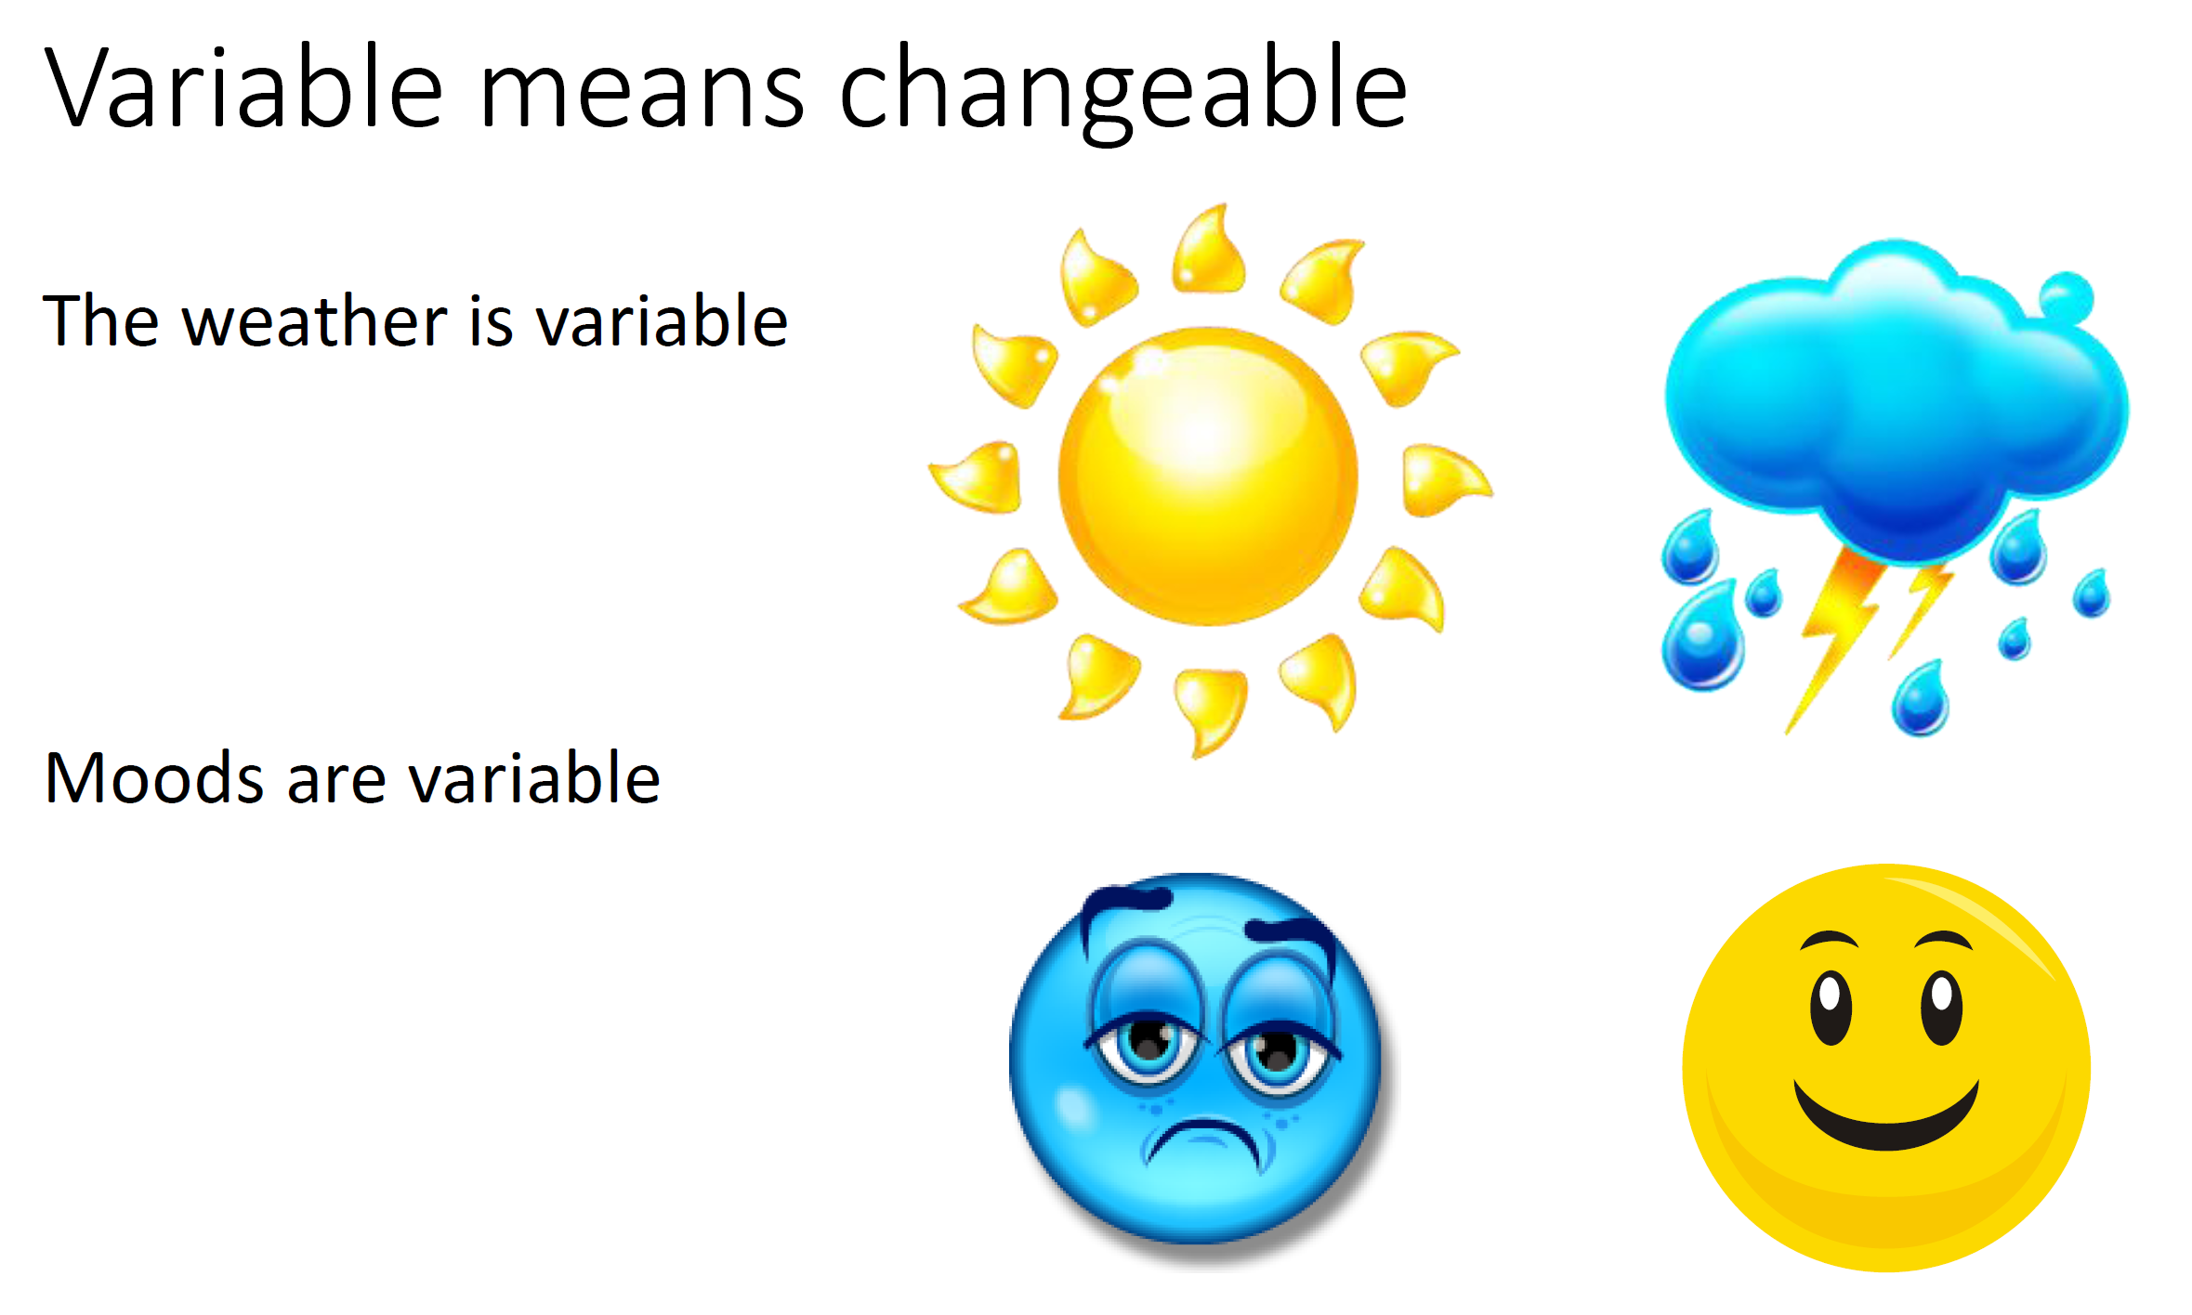
Bagge (2014) www.code-it.co.uk/scratch/perimeter/variablewriting.pdf

Slide 6
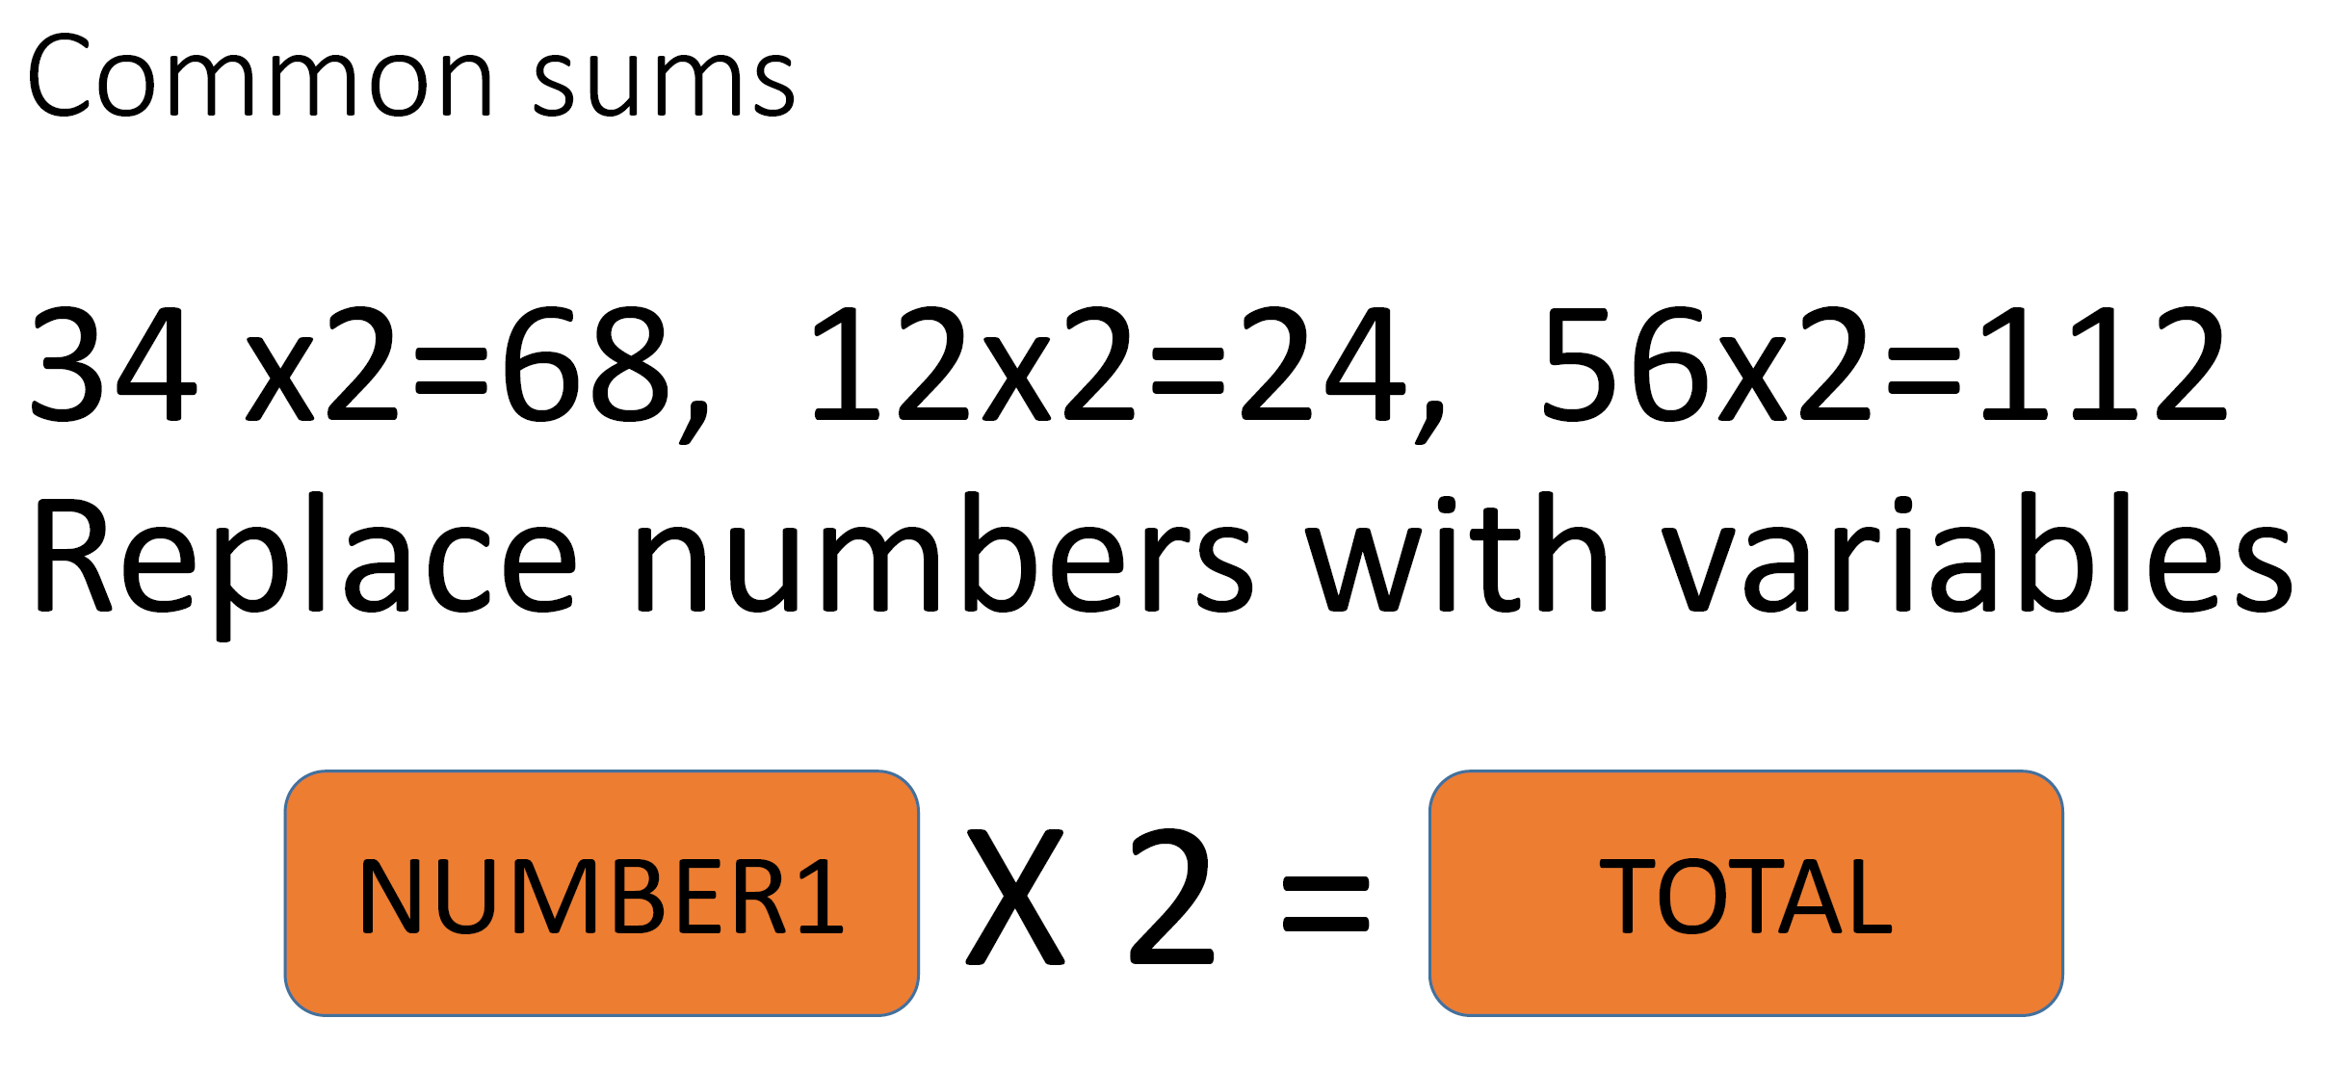

NUMBER1
TOTAL

Slide 7
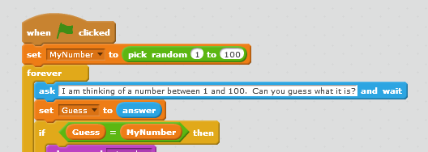
Assigning Data to Variables
Note how we capture the keyboard input

Slide 8
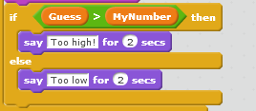
If Then Else

Slide 9
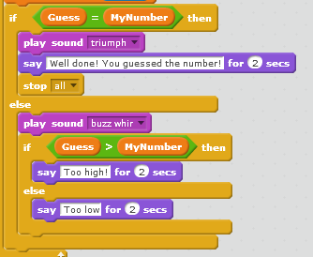
Nested If

Slide 10

Operators

Slide 11
OK… on with the programming
I want you to make a game where the computer ‘thinks’ of a number and the player has to guess what it is.
The computer will keep giving them opportunities to guess until they get it right.
Work together on this task
I want you to struggle just a little bit so you can feel the burn of the debugging process

